Slide 1

University of Basrah
College of Nursing
Pediatric nursing Lap.
IV Fluids and Solutions Guide
Prepared by:- assist lect. Noor salah shreef

Slide 2
What are IV Fluids?
Intravenous fluids (IV Fluids), also known as intravenous solutions, are supplemental fluids used in intravenous therapy to restore or maintain normal fluid volume and electrolyte balance when the oral route is not possible. IV fluid therapy is an efficient and effective way of supplying fluids directly into the intravascular fluid compartment, in replacing electrolyte losses, and in administering medications and blood products.

Slide 3
Types of IV Fluids
There are different types of IV fluids and different ways on how to classify them.
The most common way to categorize IV fluids is based on their tonicity:
Isotonic. Isotonic IV solutions that have the same concentration of solutes as blood plasma.
Hypotonic. Hypotonic solutions have lesser concentration of solutes than plasma.
Hypertonic. Hypertonic solutions have greater concentration of solutes than plasma.

Slide 4
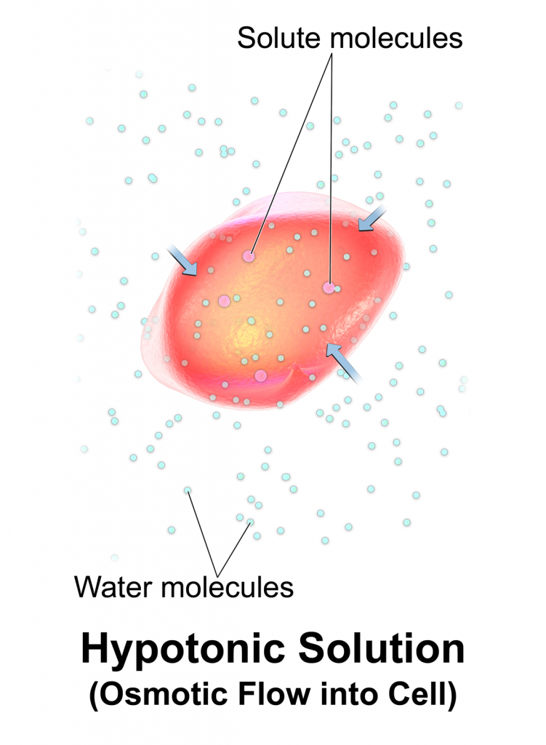
Isotonic IV Fluids
Most IV fluids are isotonic, meaning, they have the same concentration of solutes as blood plasma. When infused, isotonic solutions expand both the intracellular fluid and extracellular fluid spaces, equally.

Slide 5
Types Isotonic IV Fluids
Normal saline solution (0.9% NaCl) or NSS, is a crystalloid isotonic IV fluid that contains water, sodium (154 mEq/L), and chloride (154 mEq/L). It is called normal saline solution because the percentage of sodium chloride dissolved in the solution is similar to the usual concentration of sodium and chloride in the intravascular space.
Normal saline is the IV fluid used alongside the administration of blood products. It is also used to replace large sodium losses such as in burn injuries and trauma. It should not be used for heart failure, pulmonary edema, and renal impairment, or conditions that cause sodium retention as it may risk fluid volume overload.

Slide 6
D5W (dextrose 5% in water) 5% Dextrose in Water (D5W) *starts as isotonic and then changes to hypotonic when dextrose is metabolized. A liter of D5W provides fewer than 200 kcal and contains 50g of glucose. Provides free water to help renal excretion of solutes, hypernatremia, and some dextrose supplementation.

Slide 7
Lactated Ringer’s Solution (also known as Ringer’s Lactate) is a crystalloid isotonic IV fluid designed to be the near-physiological solution of balanced electrolytes. It contains of sodium, potassium, calcium, and chloride.
Lactated Ringer’s is used to correct dehydration, sodium depletion, and replace GI tract fluid losses. It can also be used in fluid losses due to burns, fistula drainage, and trauma. It is the choice for first-line fluid resuscitation for certain patients.
it should not be given to patients who cannot metabolize lactate (e.g., liver disease, lactic acidosis). It should be used in caution for patients with heart failure and renal failure.

Slide 8
Ringer’s solution is another isotonic IV solution that has content similar to Lactated Ringer’s Solution but does not contain lactate. Indications are the same for Lactated Ringer’s but without the contraindications related to lactate.

Slide 9
Nursing Considerations for Isotonic IV Solutions
Document baseline data. Before infusion, assess the patient’s vital signs, edema status, lung sounds, and heart sounds. Continue monitoring during and after the infusion.
Observe for signs of fluid overload. Look for signs of hypervolemia such as hypertension, bounding pulse, pulmonary crackles, dyspnea, shortness of breath, peripheral edema, jugular venous distention, and extra heart sounds.
Monitor manifestations of continued hypovolemia. Look for signs that indicate continued hypovolemia such as, decreased urine output, poor skin turgor, tachycardia, weak pulse, and hypotension.

Slide 10
Prevent hypervolemia. Patients being treated for hypovolemia can quickly develop fluid overload following rapid or over infusion of isotonic IV fluids.
Educate patients and families. Teach patients and families to recognize signs and symptoms of fluid volume overload. Instruct patients to notify their nurse if they have trouble breathing or notice any swelling.
Close monitoring for patients with heart failure. Because isotonic fluids expand the intravascular space, patients with hypertension and heart failure should be carefully monitored for signs of fluid overload.

Slide 11
Hypotonic IV Fluids
Hypotonic IV solutions have a lower osmolality and contain fewer solutes than plasma. They cause fluid shifts from the ECF into the ICF to achieve homeostasis, therefore, causing cells to swell and may even rupture.

Slide 12
Types of Hypotonic IV solutions
0.45% Sodium Chloride (0.45% NaCl)
Sodium chloride 0.45% (1/2 NS), also known as half-strength normal saline, is a hypotonic IV solution used for replacing water in patients who have hypovolemia with hypernatremia. Hypotonic sodium solutions are used to treat hypernatremia.
0.33% Sodium Chloride Solution is used to allow kidneys to retain the needed amounts of water and is typically administered with dextrose to increase tonicity. It should be used in caution for patients with heart failure and renal insufficiency.

Slide 13
0.225% Sodium Chloride (0.225% NaCl)
0.225% Sodium Chloride Solution is often used as a maintenance fluid for pediatric patients as it is the most hypotonic IV fluid available at. Used together with dextrose.
2.5% Dextrose in Water (D2.5W)
Another hypotonic IV solution commonly used is 2.5% dextrose in water (D2.5W). This solution is used to treat dehydration and decreased the levels of sodium and potassium. It should not be administered with blood products as it can cause hemolysis of red blood cells.

Slide 14
Nursing Considerations for Hypotonic IV Solutions
Document baseline data. Before infusion, assess the patient’s vital signs, edema status, lung sounds, and heart sounds. Continue monitoring during and after the infusion.
Do not administer in contraindicated conditions. Hypotonic solutions may increase hypovolemia and hypotension causing cardiovascular collapse. Avoid use in patients with liver disease, trauma, or burns.
Risk for increased intracranial pressure (IICP). Should not be given to patients with risk for IICP as the fluid shift may cause cerebral edema (remember: hypotonic solutions make cells swell).
Do not administer along with blood products. Most hypotonic solutions can cause hemolysis of red blood cells especially during rapid infusion of the solution.

Slide 15
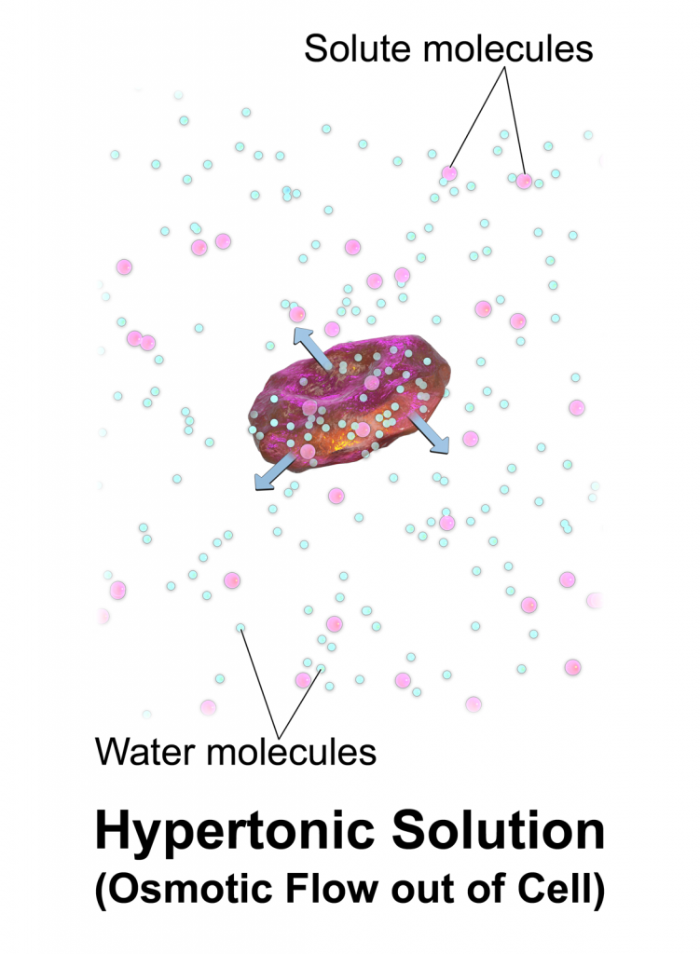
Hypertonic IV solutions have a greater concentration of solutes than plasma and cause fluids to move out of the cells and into the ECF in order to normalize the concentration of particles between two compartments. This effect causes cells to shrink and may disrupt their function.

Slide 16
Types of Hypertonic IV solutions
Hypertonic Sodium Chloride IV Fluids
Hypertonic sodium chloride solutions contain a higher concentration of sodium and chloride than normally contained in plasma. Infusion of hypertonic sodium chloride solution shifts fluids from the intracellular space into the extracellular space. Hypertonic sodium chloride IV solutions are available in the following forms and strengths:
3% sodium chloride (3% NaCl)
5% sodium chloride (5% NaCl)
Hypertonic Dextrose Solutions
Dextrose 10% in Water (D10W)
Hypertonic sodium chloride solutions are used in the acute treatment of sodium deficiency (severe hyponatremia) and should be used only in critical situations to treat hyponatremia. They need to be infused at a very low rate to avoid the risk of overload and pulmonary edema.

Slide 17
Dextrose 50% in Water (D50W)
Another hypertonic IV solution used commonly is Dextrose 50% in Water (D50W) which is used to treat severe hypoglycemia and is administered rapidly via IV bolus

Slide 18
Nursing Considerations for Hypertonic IV Fluids
Document baseline data. Before infusion, assess the patient’s vital signs, edema status, lung sounds, and heart sounds. Continue monitoring during and after the infusion.
Watch for signs of hypervolemia. Since hypertonic solutions move fluid from the ICF to the ECF, they increase the extracellular fluid volume and increases the risk for hypervolemia. Look for signs of swelling in arms, legs, face, shortness of breath, high blood pressure, and discomfort in the body (e.g., headache, cramping).
Monitor and observe the patient during administration. Hypertonic solutions should be administered only in high acuity areas with constant nursing surveillance for potential complications.

Slide 19
Assess health history. Patients with kidney or heart disease and those who are dehydrated should not receive hypertonic IV fluids. These solutions can affect renal filtration mechanisms and can easily cause hypervolemia to patients with renal or heart problems.
Prevent fluid overload. Ensure that administration of hypertonic fluids does not precipitate fluid volume excess or overload.
Monitor blood glucose closely. Rapid infusion of hypertonic dextrose solutions can cause hyperglycemia. Use with caution for patients with diabetes mellitus.

Slide 20


